Slide 1
Fundamentals of Testing

Slide 2
What is the scope of software testing?

Slide 3
How does testing fit in?
Development lifecycle: (very?) Classic view of testing (testing the produced code post-compilation)
- This type of testing has quite a complex interplay with other lifecycle activities – as can be seen.
Requirements
Maintaining
Design
- Traditionally the role of the software testers or the software test team / department.
Shipping
Coding
- A complex and expensive activity in its own right.
Fixing
Testing
- Agile software development is different again.
- But this is just one aspect of the software testing domain.

Slide 4
How does testing fit in?
Development lifecycle: Broader scope of testing domain (testing throughout the lifecycle)
Requirements Testing
Maintenance Testing
Requirements
Design Testing
Maintaining
Design
Acceptance Testing
Code Testing
Shipping
Coding
- Testing is everywhere
- Testing is expensive
Fixing
Testing
- Not testing enough can be more expensive; there is an economic consideration.
- Note on integration versus system/qualification versus acceptance testing
Application / Product Testing
- This module is concerned with all of these different types of testing.

Slide 5
Why is testing necessary?

Slide 6
Why testing is important?
7 out of 10 IT projects fail and the reasons for failure can often be attributed to poor software testing.
Software testing can represent c.40% of development costs within a project.
There are significant cost, time and quality benefits to getting software testing right.
Unfortunately, organisations often struggle to attain the desired balance between test coverage and time to delivery.
After spending $130 million on it's problematical health insurance exchange, one of the 14 U.S. states that opted to create their own health insurance exchange (rather than utilize a federal-government-provided exchange) hired a new contractor in April 2014 to redo the site. Among the many problems with the initial site since it went live in October 2013, reportedly hundreds of enrollees receiving enrollment information with names and birth dates of other enrollees. It was estimated the revamping would cost another $60 million. Additionally, the primary contractor and subcontractor for the site are embroiled in a lawsuit with one another and at last report were in arbitration. Eventually it was reported that the prime contractor agreed to pay $45 million to the government to avoid a lawsuit.
Notes:
(PQ) Is anyone in the room familiar with the recent incident with the airline in question?
If someone expresses knowledge of it, ask them to relate to the rest of the room about the root of the problem. If not describe the situation.
Ask if anyone can cite another recent example when inadequate testing was the cause of issues to an organization:
(EXAMPLE) Toyota – Recall of cars because of braking failure
Use the rest of the slide content to discuss how important testing is.
Highlight Willie Walsh’s statement and the importance he placed on good testing.

Slide 7
Certain test activities are one of the final activities.
Because testing is one of the last tasks prior to customer delivery, well intentioned and appropriately planned testing activities are often subject to significant time pressure.
In this instance – it is not good to be last.
Notes:
(PQ) Is anyone in the room familiar with the recent incident with the airline in question?
If someone expresses knowledge of it, ask them to relate to the rest of the room about the root of the problem. If not describe the situation.
Ask if anyone can cite another recent example when inadequate testing was the cause of issues to an organization:
(EXAMPLE) Toyota – Recall of cars because of braking failure
Use the rest of the slide content to discuss how important testing is.
Highlight Willie Walsh’s statement and the importance he placed on good testing.

Slide 8
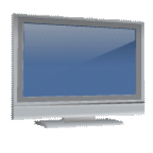
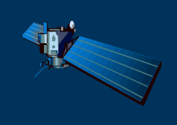

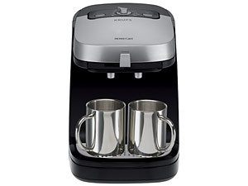
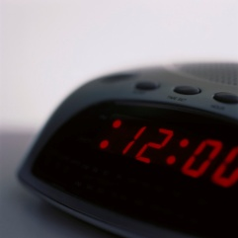
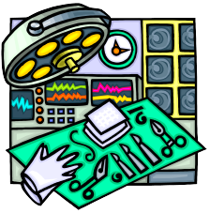
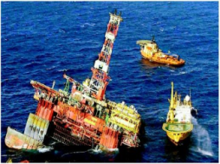
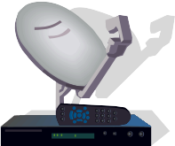
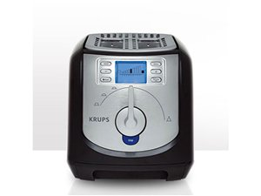
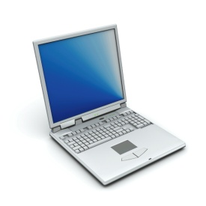




Software is a Skin that Surrounds Our Civilization
53

Slide 9
Fundamentals continued…
Static and Dynamic Testing

Slide 10


Trivia Quiz: Lines of code
>20 million
6.5 million
Notes:
(PQ) Can you guess how many lines of code were used in the systems for these machines?

Slide 11
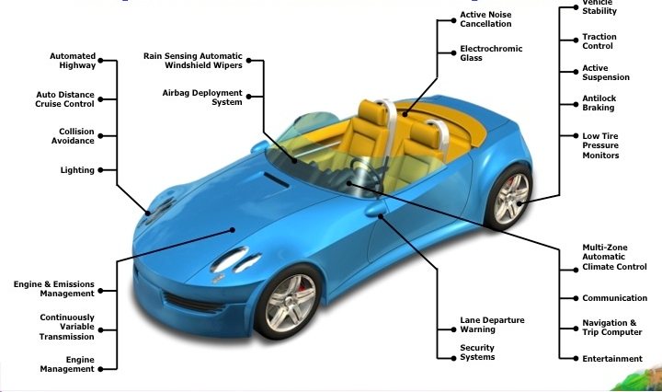
Think about what is really inside a car

Slide 12
Failures in Production Software
NASA’s Mars lander, September 1999, crashed due to a unit integration fault—over $50 million US !
Huge losses due to web application failures
Financial services : $6.5 million per hour
Credit card sales applications : $2.4 million per hour
In Dec 2006, amazon.com’s BOGO offer turned into a double discount
2007 : Symantec says that most security vulnerabilities are due to faulty software
Stronger testing could solve most of these problems
World-wide monetary loss due to poor software is staggering
53

Slide 13
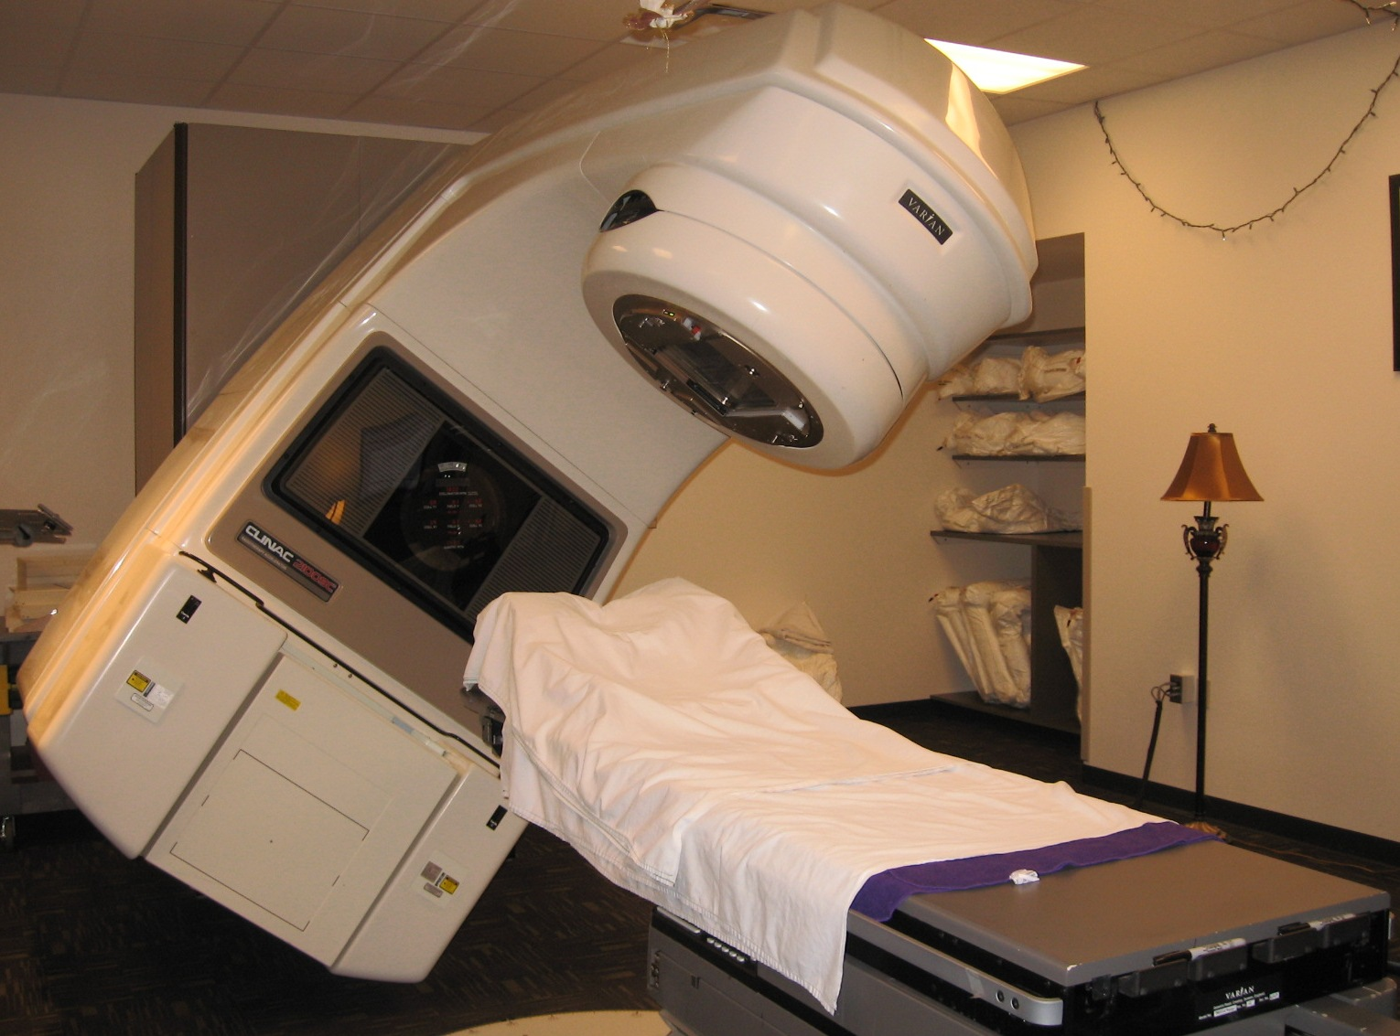

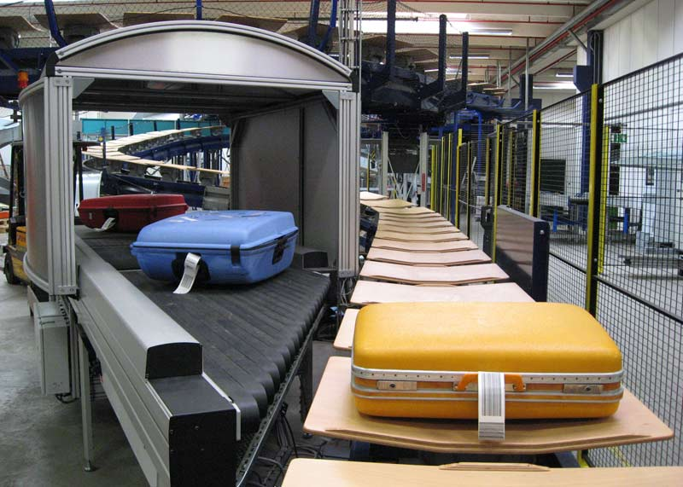
Types of failure
Examples of famous (or infamous) failures:
Therac-25 (1985-1987)
London Ambulance System (1992)
Denver baggage handling system
(1990’s)
Taurus (1993)
Ariane 5 (1996)
E-mail buffer overflow (1998)
USS Yorktown (1998)
Mars Climate Orbiter (September 23rd, 1999)
Notes:
Therac 25 – 6 accidents – 2 software faults – 100x dose of radiation over narrower area – poor software design and development practices – 4 deaths, 2 others with life long injuries
London Ambulance – Computer Aided Dispatch – 2500 calls, 200 ambulances - 30 to 45 deaths? – went live without load testing and 81 software issues – training 10 month previous – incomplete data and user interface issues
Denver Baggage Handling System – airport idle 16 months – 560 million added to cost of the airport – never implemented properly and scrapped in August 2005 - Underestimation of complexity. Complex architecture. Changes in requirements. Underestimation of schedule and budget. Dismissal of advice from experts. Failure to build in backup or recovery process to handle situations in which part of the system failed. The tendency of the system to enjoy eating people’s baggage.
Taurus – London Stock Exchange - electronic system for the transfer of shares and other securities – abandoned at a cost of approx. £400 million - blamed on the fact that the system was too complicated. The proposed system consisted of a number of interlocking databases held by, amongst others, institutions, which were to be known as "controllers". But there were immense technical difficulties in tying together the databases in a secure and error free manner.
Ariane 5 - On June 4th, 1996, the very first Ariane 5 rocket ignited its engines and began speeding away from the coast of French Guiana. 37 seconds later, the rocket flipped 90 degrees in the wrong direction, and less than two seconds later, aerodynamic forces ripped the boosters apart from the main stage at a height of 4km. This caused the self-destruct mechanism to trigger, and the spacecraft was consumed in a gigantic fireball of liquid hydrogen.
The disastrous launch cost approximately $370m, led to a public inquiry, and through the destruction of the rocket’s payload, delayed scientific research into workings of the Earth’s magnetosphere for almost 4 years. The Ariane 5 launch is widely acknowledged as one of the most expensive software failures in history. The fault was quickly identified as a software bug in the rocket’s Inertial Reference System - the software attempted to stuff a 64-bit variable, which can represent billions of potential values, into a 16-bit integer, which can only represent 65,535 potential values.
USS Yorktown - a division by zero error on board the USS Yorktown (CG-48) Remote Data Base Manager brought down all the machines on the network, causing the ship's propulsion system to fail.
Mars Climate Orbiter - The mission was unsuccessful due to a navigation error caused by a failure to translate English units to metric.

Slide 14

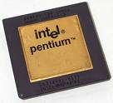
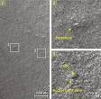
Why Does Testing Matter?
Ariane 5:
exception-handling
bug : forced self
destruct on maiden
flight (64-bit to 16-bit
conversion: about
370 million $ lost)
NIST report, “The Economic Impacts of Inadequate Infrastructure for Software Testing”
Inadequate software testing costs the US alone between $22 and $59 billion annually
Better approaches could cut this amount in half
Major failures: Ariane 5 explosion, Mars Polar Lander, Intel’s Pentium FDIV bug
Insufficient testing of safety-critical software can cost lives:
THERAC-25 radiation machine: 3 dead
We want our programs to be reliable
Testing is how, in most cases, we find out if they are
Mars Polar
Lander crash
site?
53

Slide 15
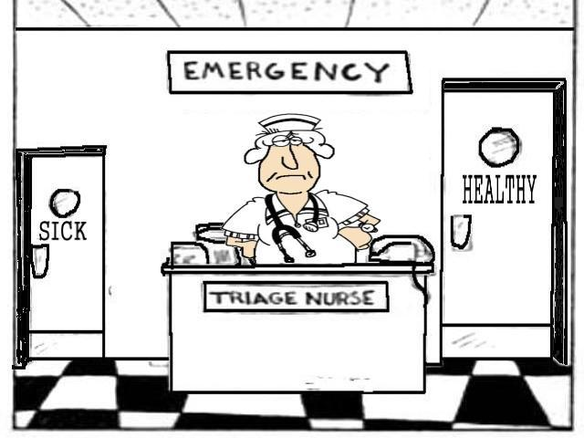
Smaller scale – defects not publicised
Software companies have to maintain their software, which is costly.
Potential defects are reported – as issues - from users / clients
Issues are prioritised, examined and resolved.
Some issues are the result of defects.
Triage is required.
53

Slide 16
Causes of software defects
A human being can make an error (mistake), which produces a defect (fault, bug) in the code, in software or a system, or in a document
If the code is executed, the system will fail, causing a failure
Defects in software, systems or documents may result in failures, but not all defects do so
Failures can be caused by environmental conditions as well:
radiation, magnetism, electronic fields, and pollution can cause faults in firmware or influence the execution of software by changing hardware conditions.

Slide 17
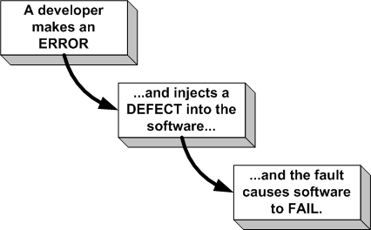
Errors, defects and failures
Some limitations in this view?
Simplistic view?

Slide 18
A failure is…
“A failure is present if a warrantable (user) expectation is not fulfilled adequately.”
Examples of failures include: products that are too hard to use, or too slow, even if they still fulfill the functional requirements. i.e. when a user experiences a problem.
A failure is: a deviation of the software from its expected delivery or service
A failure occurs when software does the 'wrong' thing
Most of the time software does the right thing
Software defects cause software failures when the program is executed with a set of inputs that expose the defect.

Slide 19
Terminology…
Sometimes a failure will be called a “problem”, “incident” “issue”

Slide 20
A defect is…
A manifestation of human error in software
Defects may be caused by requirements, design or coding errors
They are discovered either by inspecting code or by inferring their existence from software failures.

Slide 21
Terminology…
Sometimes a defect will be called a “bug” or a “fault”

Slide 22
An error is…
A human action producing an incorrect result
When programmers make errors they introduce faults to program code
Errors are not
Errors are not just accidents or mistakes
Errors are not cured by "just being more careful"
Errors are not necessarily an act of incompetence
Errors are inevitable in a complex activity.

Slide 23
Fundamentals continued…
Software complexity
Role of testing in development, maintenance and operations
Testing and…..

Slide 24
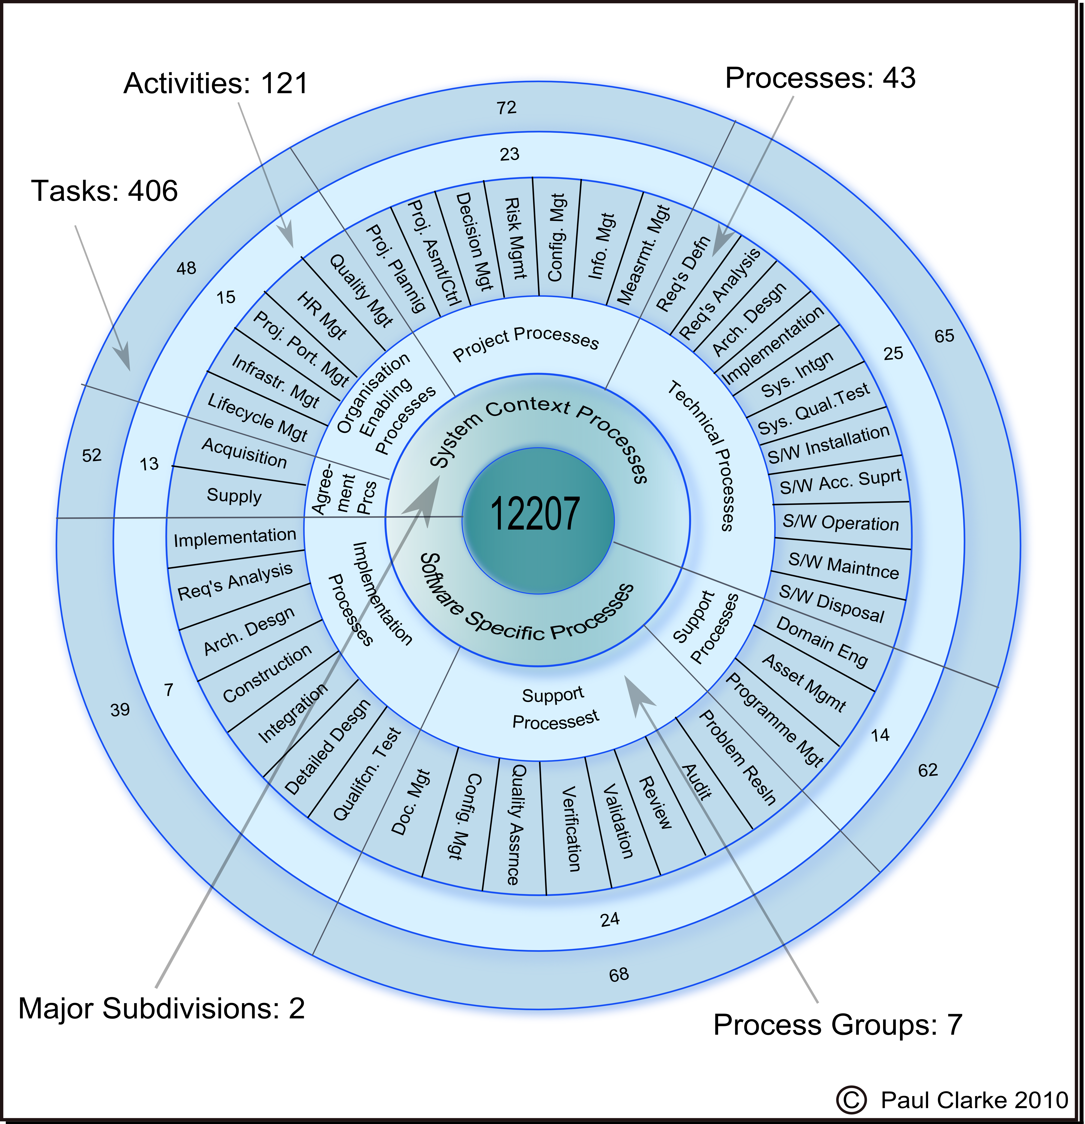
How complex is software development?

Slide 25
Role of testing in development, maintenance and operations
Rigorous testing of systems and documentation can help to:
  reduce the risk of problems occurring in an operational environment
  and contribute to quality
Software testing may also be required:
  to meet contractual or legal requirements,
  or industry-specific standards.

Slide 26
Testing and confidence
If we buy a software package
we may believe it works, but...
a test gives us the confidence that it will work
When we buy a car, cooker, off-the-peg suit
we assume they work, but do they work for me?
we still test them
When we buy a kitchen, haircut, bespoke suit
we were involved in the requirements
and we test them.

Slide 27
Testing and contractual requirements
When we buy custom-built software, a contract will usually state
the requirements for the software
the price of the software
the delivery schedule and acceptance process
We don't pay the supplier until we have received and acceptance tested the software
Acceptance tests help to determine whether the supplier has met the requirements.

Slide 28
Testing and other requirements
Software requirements may be imposed:
  laws governing our industry must be obeyed
  industry regulations must be adhered to
  our customers may insist we are compliant
  industry standards (e.g. safety-critical software)
When we write, change or buy software, we have to provide evidence that we comply
Testing provides most of that evidence.

Slide 29
Testing and quality
Testing can measure quality of a product and indirectly, improve its quality.
Testing measures quality
if we assess the rigour and number of tests and if we count the number of faults found...
we can make an objective assessment of the quality of the system under test
Testing improves quality
tests aim to identify defects
if defects are found, we can improve the quality of the software.

Slide 30
Fundamentals continued…
How much testing is enough?

Slide 31
How much testing is enough?
A perplexing question
There's no upper limit
If we don't test enough, we get blamed for faults in production
The tester can't 'win'.
Think of managing a deficit or a surplus.

Slide 32
How much testing is enough?
There are an infinite number of tests we could apply and software is never perfect
So how much testing is enough?
Objective coverage measures can be used:
standards may impose a level of testing
test design techniques give an objective target
But all too often, time is the limiting factor
so we may have to rely on a consensus view to ensure we do at least the most important tests.

Slide 33
Complete Testing is not practically feasible (1)
Consider a simple little program that consists of a loop in which there are 5 possible execution paths from the start of the loop to the end of the loop.
If the maximum number of iterations of the loop is 20 then there is: 5²⁰ +5¹⁹ +5¹⁸ +...+5¹ different execution traces. That's about 100 quadrillion different execution traces.
If each test is done manually and takes 5 minutes to test each trace then the full test takes 1 billion years.
If automated so that each test takes 5 microseconds, then it would take 19 years!

Slide 34
Complete Testing is not practically feasible (2)
Complete testing is nearly impossible because of the following reasons:
The domain of possible inputs of a program is too large to be completely used in testing a system. There are both valid inputs and invalid inputs.
The program may have a large number of states.
The design issues may be too complex to completely test (especially for larger systems)
It may not be possible to create all possible execution environments of the system

Slide 35
The bugs that lurk in our systems

Slide 36
Fundamentals continued…
Where are the bugs?

Slide 37
Where are the bugs?
Of course, if we knew that, we could fix them and go home!
Experience tells us
bugs are sociable! - they tend to cluster
some parts of the system will be relatively bug-free (bought-in or unchanged code)
bug fixing and maintenance are error-prone – and some changes cause unintended faults.

Slide 38
Testing as a fishing net
Size of the net reflects size of the test
Density of the mesh reflects test depth or thoroughness
Large nets, large mesh to give overall confidence
Small nets, fine mesh to find bugs
use in areas that are critical to make sure the bugs aren’t there
use in areas where we expect lots of bugs.

Slide 39
Coverage of business-oriented tests

Slide 40
Rigorous tests of the riskiest parts of the system

Slide 41
More tests of the business critical parts of the system

Slide 42
What about the bugs we don’t find?

Slide 43
What about the bugs we don’t find?
If not in the business critical parts of the system - would the users care?
If not in the system critical parts of the system - should be low impact
If they are in the critical parts of the system
should be few and far between
should be pushed to the domain of obscure usage.

Slide 44
Fundamentals continued…
What is testing?

Slide 45
What is testing?
Testing
The systematic exploration of a component/system with the main aim
of finding and reporting defects.
Testing rigorously examines the component/system behaviour and reports defects found.
Tests are repeated to ensure that
defect corrections have been effective.
Debugging
A process undertaken by developers
to identify the cause of defects in code and undertake corrections.
Debugging is done first to ensure that the component or system is at a level
to enable rigorous testing.
Debugging can be used to understand the root cause of observed failures.
Notes:
Describe the different between testing and debugging using the slide content as a basis for discussion. Important distinction is who does it and the objective of each.
Testing – The systematic exploration of a component/system with the main aim of finding and reporting defects.
Debugging – A process that developers go through to identify the cause of defects in code and undertake corrections.
When does debugging take place?
Debugging can take place when developers test their own pieces of code (unit testing) or when defects have been discovered in order to determine their root cause. Debugging can also be used in the creation of incident reports as a method to gather further information for analysis.

Slide 46
What is testing?
What is a Test?
Thus once a Test is run, you’ll get
  An actual result / output
  A decision on its success
Controlled exercise
Object under test
Definition of the environment;
Definition of the inputs;
Definition of the expected outputs
Notes:
What is a test?
IEEE 829 defines a test as a set of one or more test cases. IEEE 610 defines a test case as a set of input values, execution preconditions, expected results and execution postconditions, developed for a particular objective or test condition, such as to exercise a particular program path or to verify compliance with a specific requirement.
Use this slide to describe what a test is paying particular attention to the keywords “controlled”, “environment”, “inputs” and “expected outputs”. When a test is executed, we will get an actual result/output and be able to decide if it is successful or not.
Turn to pre-drawn flipchart of test suites, test conditions, test cases and use this to describe the phrases below:
Test Case = A set of inputs, execution preconditions, and expected outcomes developed for a particular objective such as to exercise a particular program path or to verify compliance with a specific requirement. (BS7925)
Test Condition = A situation, event, data value, logical expression selected to exercise a coverage item. Typically, several conditions are combined to make up a test case. (BS7925)

Slide 47
Testing isn't just running tests
planning and control
choosing test conditions
designing test cases
preparing expected results
checking actual results against expected results
evaluating completion criteria
reporting on the testing process and system under test
and closing the test phase.

Slide 48
Test Objectives
There can be different test objectives:
finding defects
gaining confidence about the level of quality and providing information
preventing defects
In acceptance testing, the main objective may be to confirm that the system works as expected, to gain confidence that it has met the requirements.

Slide 49
Static and Dynamic Testing
Static Testing
Testing without executing the program
This include software inspections and some forms of analyses
Very effective at finding certain kinds of problems – especially “potential” faults, that is, problems that could lead to faults when the program is modified
Dynamic Testing
Testing by executing the program with real inputs
Includes various techniques but requires the coding stage to be completed.
Notes:
53

Slide 50
Dynamic and Static Testing
Testing also includes reviewing of documents (including source code).
Both dynamic testing and static testing can be used as a means for achieving similar objectives, and will provide information in order to improve both the system
Reviews of documents (e.g. requirements) also help to prevent defects appearing in the code.

Slide 51
Static testing in the lifecycle
Static tests are tests that do not involve executing software
Reviews, walkthroughs, inspections of (primarily) documentation
Requirements
Designs
Code
Test plans.

Slide 52
Dynamic testing in the lifecycle
Program (unit, component)
Integration or Component Integration testing
System testing
non-functional (e.g. performance, security, backup and recovery, stress)
functional where functionality as a whole is evaluated
User acceptance testing.

Slide 53
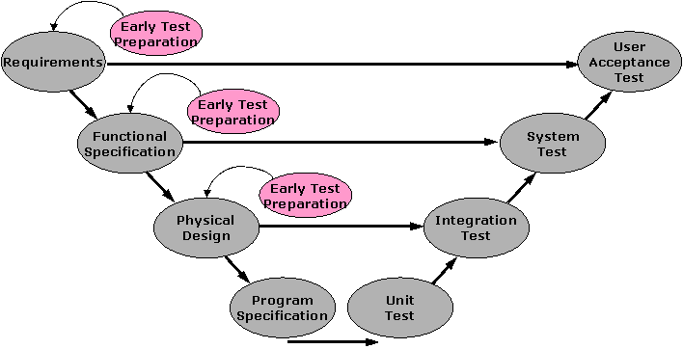
Early test case preparation

Slide 54
Fundamentals continued…
Types of Testing

Slide 55
Types of Testing
In some cases the main objective of testing may be to assess the quality of the software (with no intention of fixing defects), to give information to stakeholders
Regression/Maintenance testing often includes testing that no new errors have been introduced during development of the changes.
During operational testing, the main objective may be to assess system characteristics such as reliability or availability.

Slide 56
Types of Dynamic Testing
Software System Decomposition
System
System testing, Acceptance testing
Integration testing
Component 1
Comp. n, etc.
Regression testing
Unit 1
Unit 2, etc.
Unit 3
Unit 4, etc.
Unit Testing
Method 1
Mthd 2, etc.
Function 1
Function 2, etc.

Slide 57
Each Type Of Testing
Each type of testing addresses a specific concern:
Unit Testing: addresses the quality of individual units (e.g. methods, functions)
Integration Testing: checks if individual components (which are a combination of two or more individual units) operate together
System Testing: checks if the system as a whole delivers the desired functionality.
Other types of testing also exist that address other concerns, e.g. acceptance testing allows users or a designated user representative to establish if the system is acceptable to the users.

Slide 58
Types of Static Testing
Mostly taking the form of:
Software Lifecycle
Reviewing
Requirements Testing
Inspecting
Maintenance Testing
Requirements
Design Testing
Maintaining
Design
Acceptance Testing
Code Testing
Shipping
Coding
Fixing
Testing
Other testing:
Testing plans, including Test Plan
Testing test cases
Application / Product Testing
Testing documentation, incl User Manuals

Slide 59
Remember: Debugging and Testing
Debugging and testing are different
Testing can show failures that are caused by defects
Debugging is the programmer activity that identifies the cause of a defect, repairs the code and checks that the defect has been fixed correctly
Subsequent confirmation testing by a tester ensures that the fix does indeed resolve the failure
The responsibility for each activity is very different, i.e. testers test and developers debug.

Slide 60
Fundamentals continued…
End of Week 2 Materials

